Slide 1
CRC Internship Fieldwork Form
Daniel Dalton and Seraphim Dmitrieff
In-Class Project

Slide 2
Summary and Goals of the Project
Build an interactive form system that will replace the existing system for student field work.
Currently, the existing system involves filling out a form from Records and Registration and processing it from there. Making this form an interactive system would mean that all parties involved would have an easier time filing the clerical work.
This system would account for Students, their Employers, their supervising Instructors, their Department Chairs, their Department Deans, the Career Resource Center, and Records and Registration.

Slide 3
Description of Solution

Slide 4
A Test Workflow
The following screenshots show the workflow involved for the parties:
The Creation of a Chair Account for an imaginary department whose name is Chad Chairperson (cchair@newpaltz.edu)
The Creation of a Dean Account for that imaginary department whose name is Dean dePartment (departd@newpaltz.edu)
The Creation of a Department Secretary for that department, whose name is Sek Re-Tary (retarys@newpaltz.edu)
The Creation of a supervising Instructor whose name is Pro Fessor (fessorp@newpaltz.edu)
The Creation of a test department who has these Dean and Chair assigned to them, that is called “Computer Science Examples” with the department code “CSE”
The Creation of a Student whose name is Daniel Dalton (daltond2@hawkmail.newpaltz.edu)
The Creation of an Employer whose name is also Daniel Dalton, but the e-mail is dannyswebdesign@gmail.com
This is meant for illustrative purposes, and, besides the student and employer, any similarities to real names and e-mail addresses are purely coincidental.

Slide 5
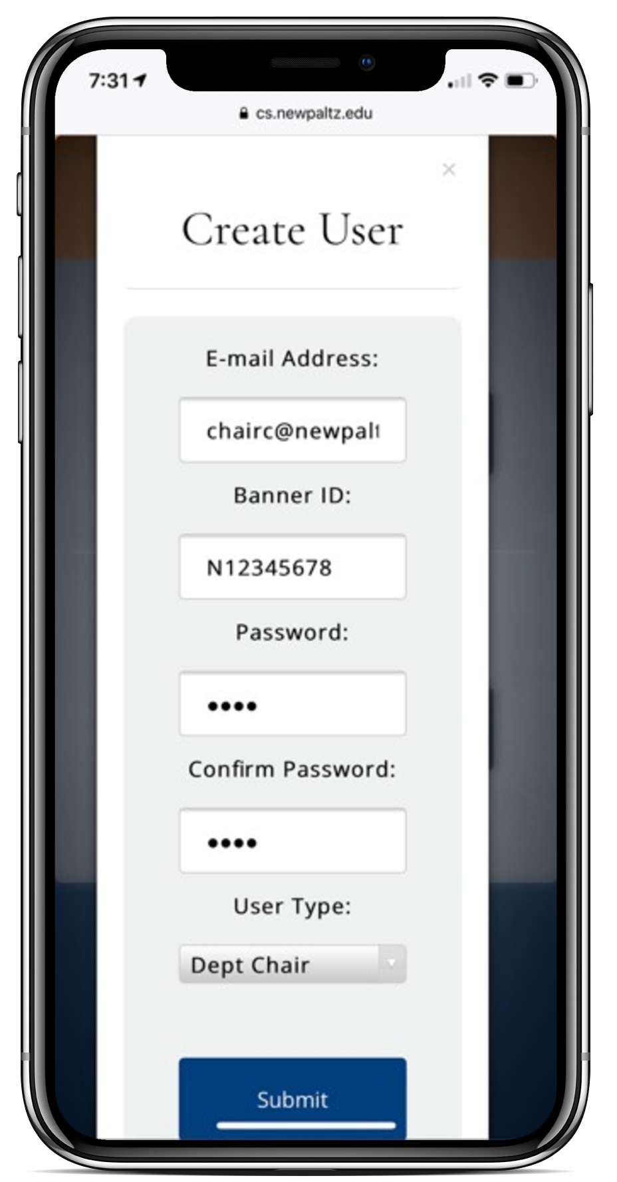
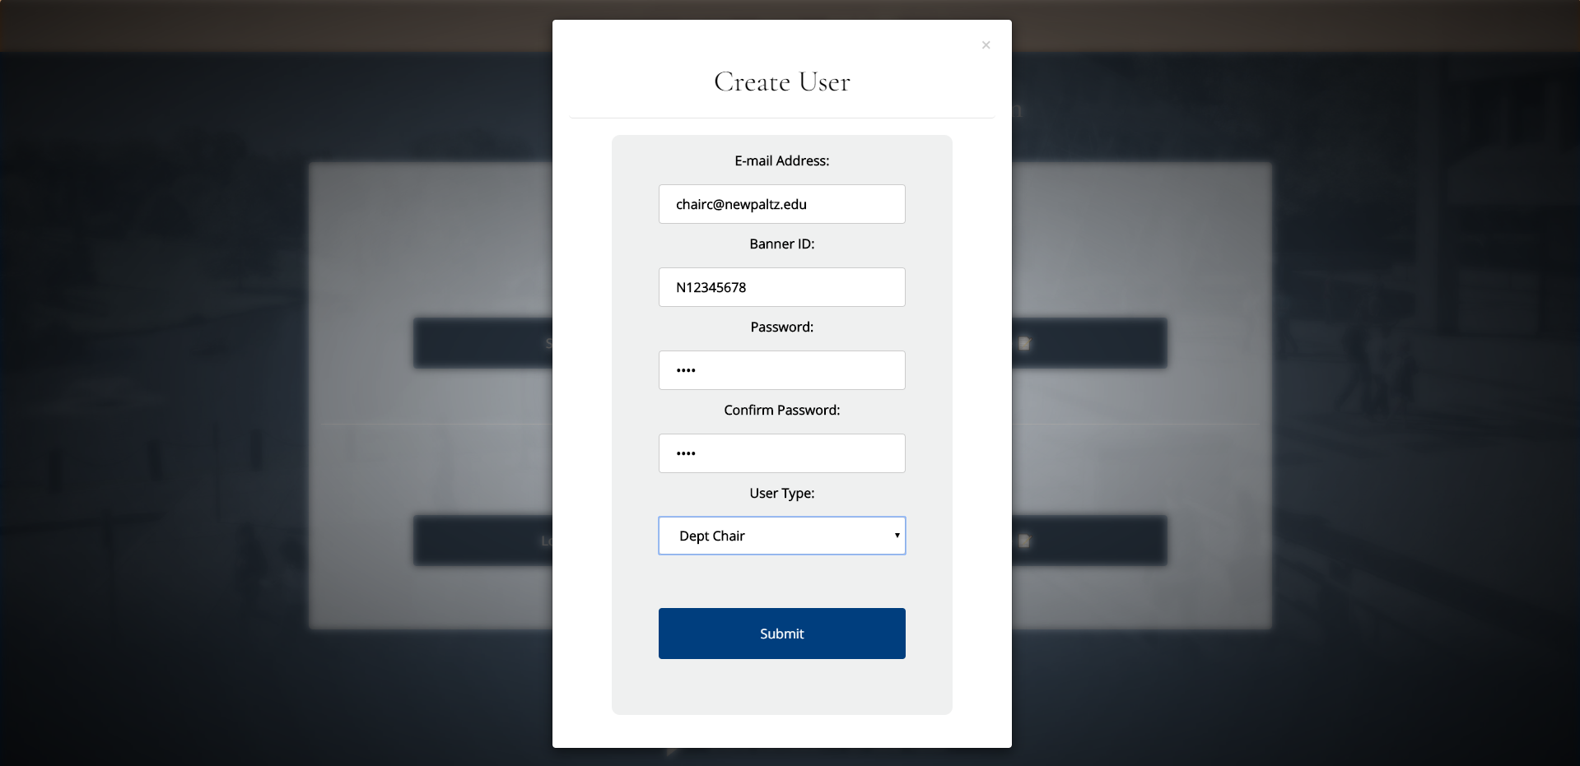
Creation of the Chair Account

Slide 6
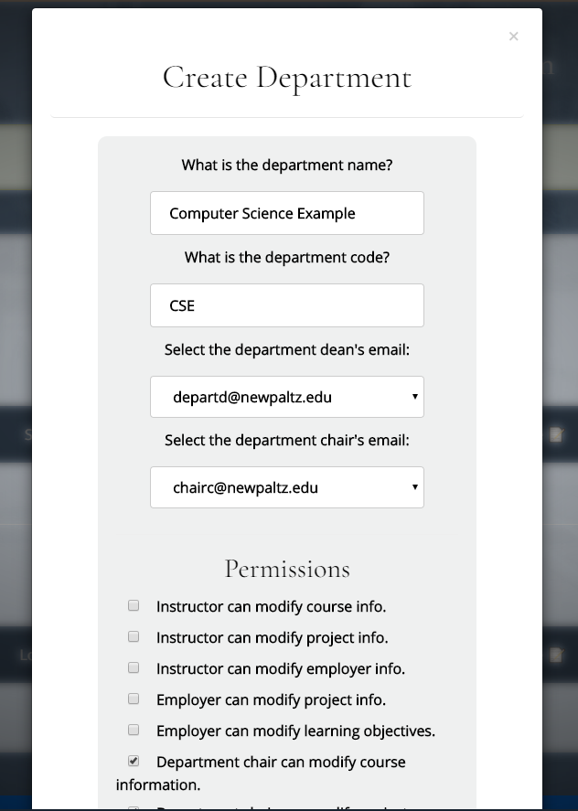
Creation of the Computer Science Example Department
Administrators (the Career Resource Center) may toggle what permissions people have in this department. Additionally, they may set e-mail preferences, as well as setting the sequence of what pages are shown.
The default is: Student ➡ Employer ➡ Instructor ➡ Chair ➡ Dean.

Slide 7
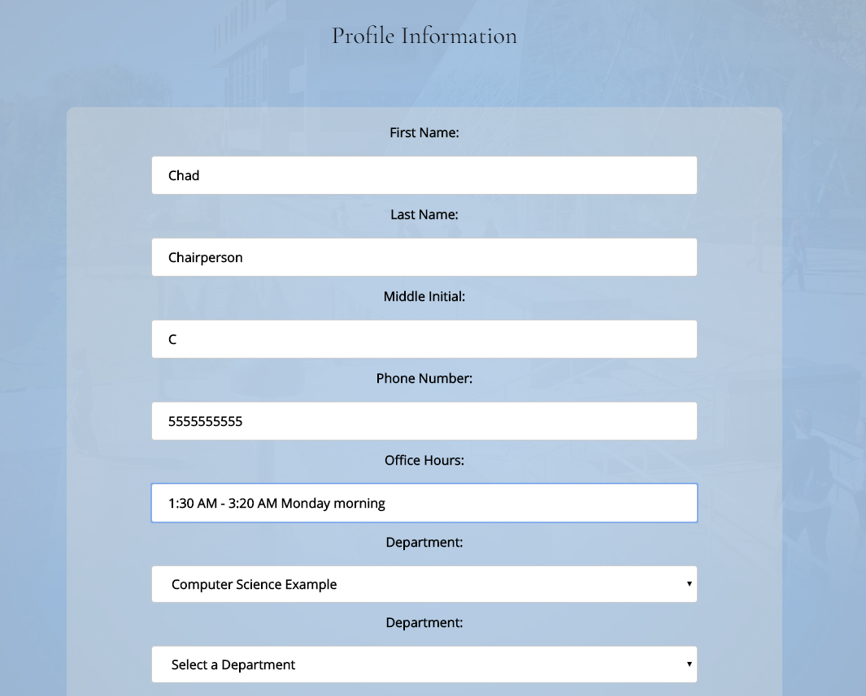
Faculty Profile Creation
Once a new faculty member gets on the system, they’ll be required to change their password, and they’ll be required to add some information on to their Profile, including their name, office hours, and whatever (other) departments they belong to.

Slide 8
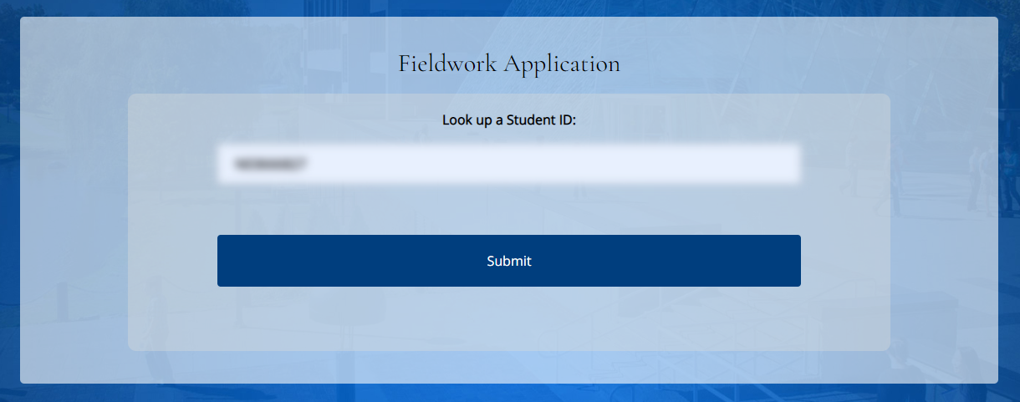
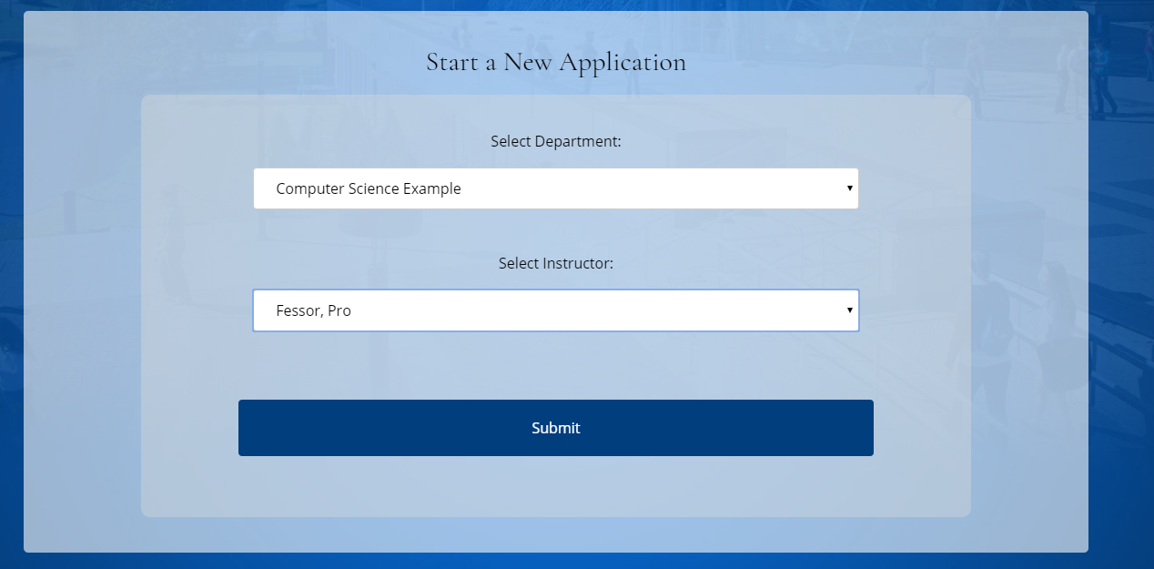
Student Creation
This is handled by the Department Secretary.
First, they must enter the Student’s banner ID number in to the system. If they exist, the secretary is prompted to make and assign a new application to them. Otherwise, the secretary is prompted for the student’s e-mail, and they are sent a password. That student is then prompted to get on and add profile information, and when that is done, the secretary may then look up that student’s ID number and assign a new application to them.

Slide 9
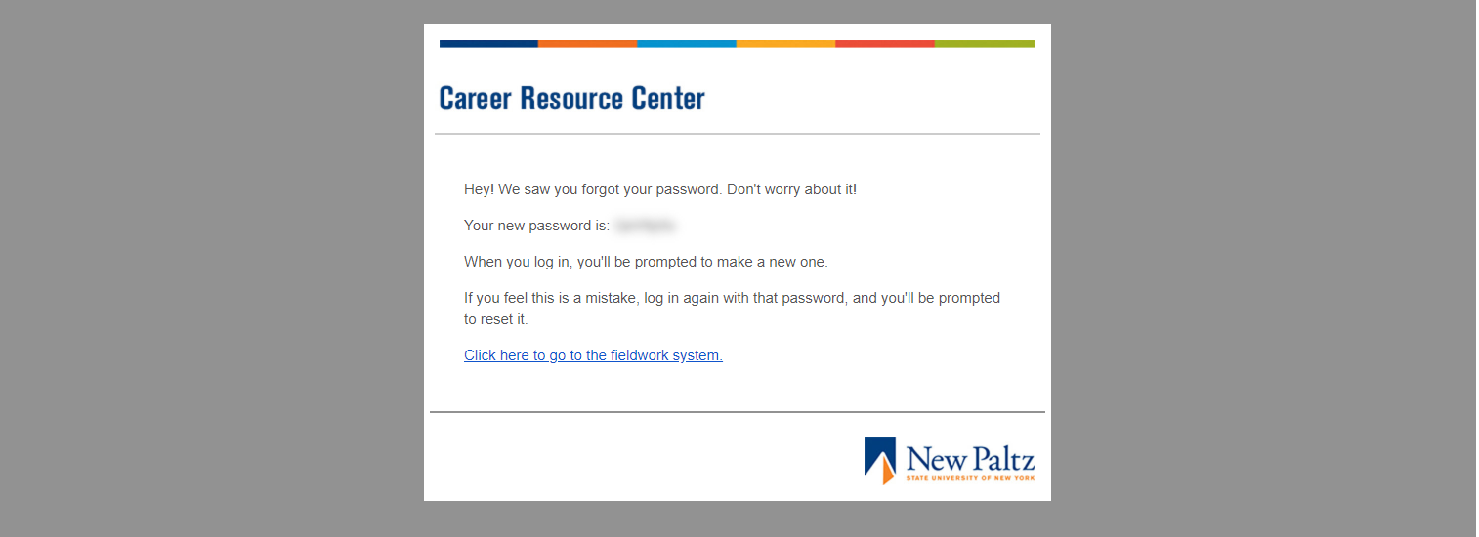
E-mail Styling
E-mails conform to the New Paltz style guide and are based off the Career Resource Center’s template. (Wording of the e-mail is subject to change and be editable.)

Slide 10
Technologies Used and Learned
Back-end:
PHP
MySQL (MariaDB)
PhpMyAdmin
Front-end:
PHP
HTML 5
CSS 3
JavaScript

Slide 11
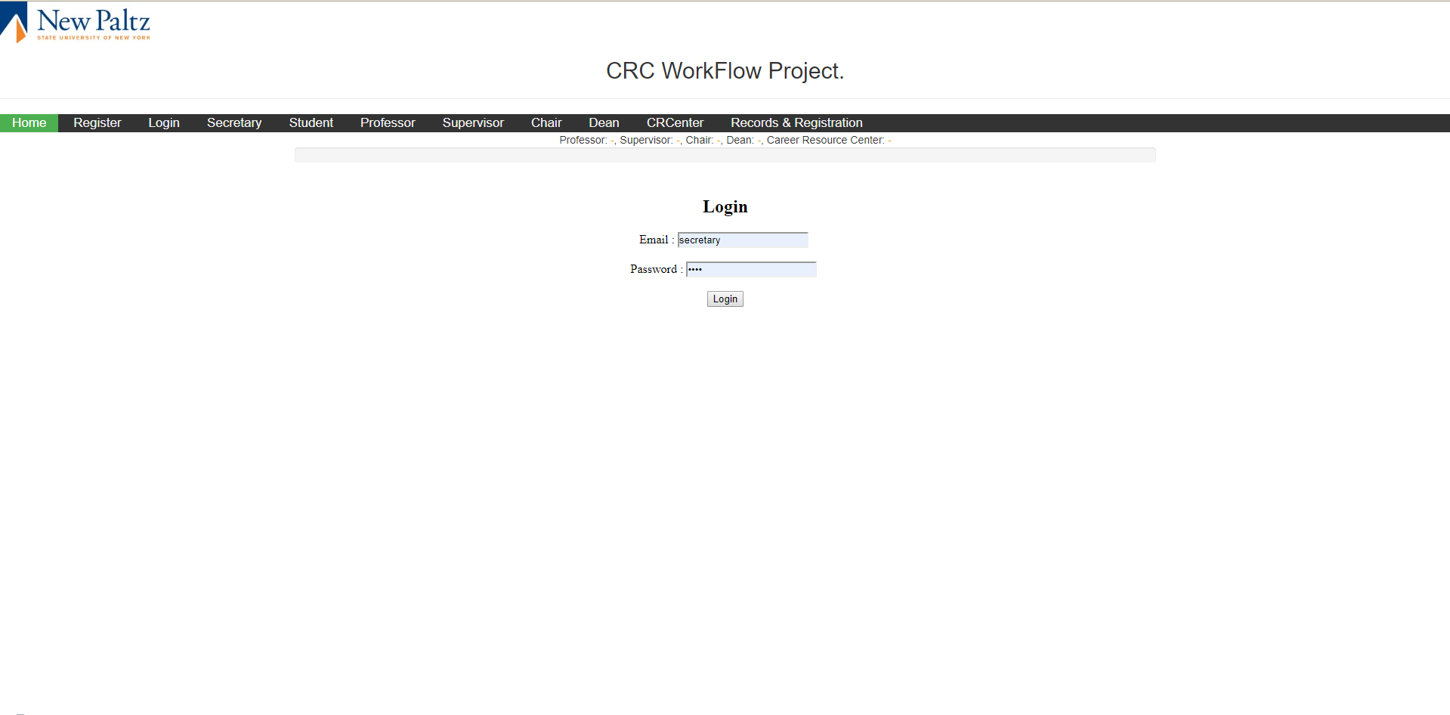
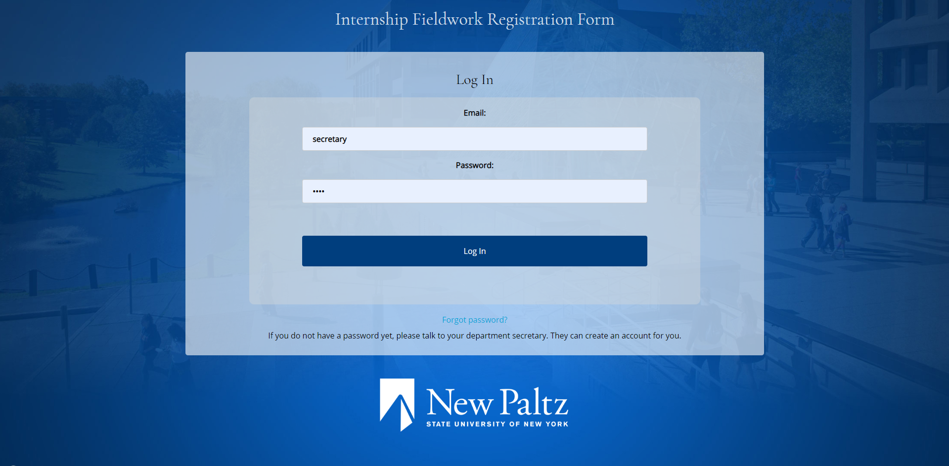
Challenges
Our biggest challenge, by far, was understanding the project at hand, and to get a real feel for our software requirements, and learning what the code from last semester actually did. We also accomplished the additional challenge of making sure that our design was conformant to the New Paltz Style Guide.
The top screenshot is the login page from last semester, and the bottom screenshot is the one from this semester.

Slide 12
Conclusions
We learned how to compartmentalize a web-based interface using PHP; by splitting each portion of our project into several smaller files, we were able to work on certain aspects of our project faster and easier.
For example: say, the Reject button didn’t work right or we wanted to add/remove a link on our navigation menu. We could instead edit a component that held the logic for our accept/reject buttons, or the logic for the navigation menu.
We also learned how MySQL queries worked and how to use them to modify entries in a database.

